Slide 1


CSCI 1304: Programming I Chapter 2 Basic Computation Part 2 Identifiers, Assignments, Expressions, and Constants
Dr. Nour Almadhoun Alserr
Week 4
1/10/2023
Notes:
Overcome Challenges

Slide 2
Objectives
Write Java statements to declare variables and define named constants.
Write assignment statements and expressions containing variables and constants.

Slide 3
Java identifiers
Identifier: the name of something in a Java program, such as a variable, class, or method.
It must not start with a digit and may contain:
Letters,
Digits 0 through 9,
The underscore character (_)
The symbol $ is also allowed (reserved)
Since Java is case sensitive, iug, Iug, and IUG are different identifiers.

Slide 4
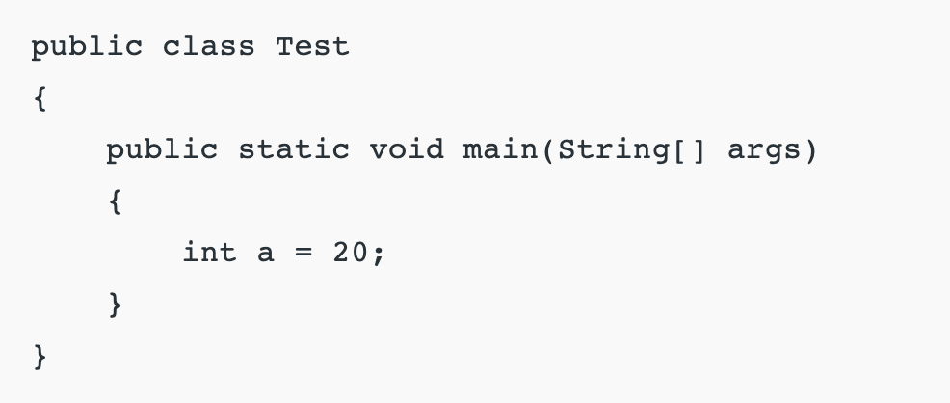
Java identifiers

Slide 5
Java identifiers
Notes:
Test: class name.
main: method name.
String: predefined class name.
args: variable name.
a: variable name.

Slide 6
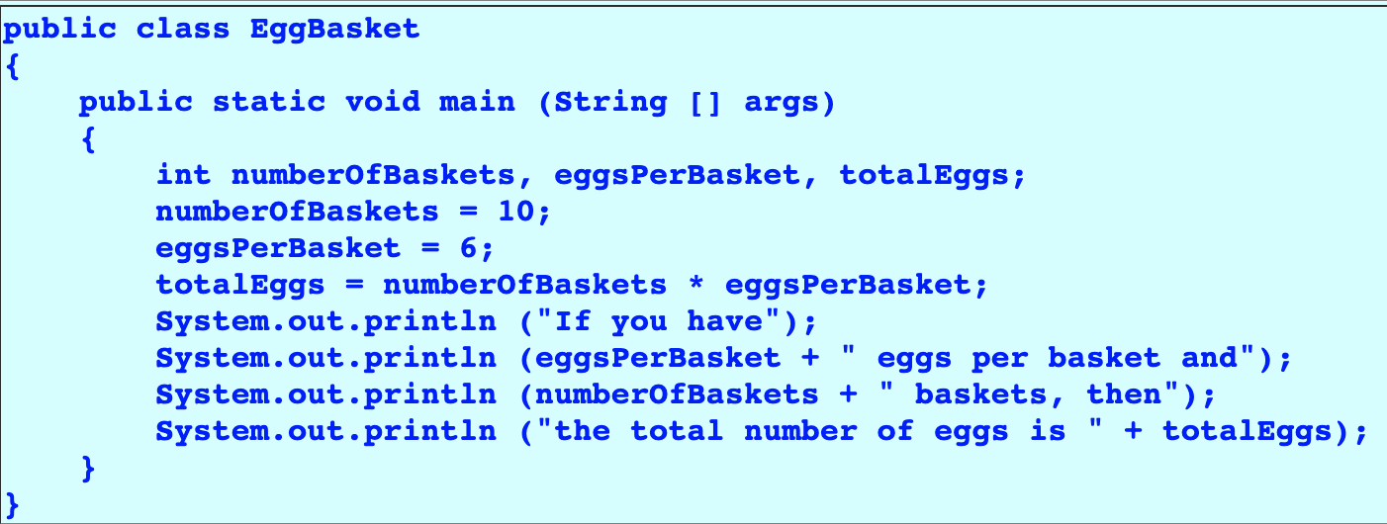
Java identifiers

Slide 7
Java identifiers
What are the valid identifiers ?!
miles
Four_Students$2021
Four Students$2021
public
int
a++
$4
Test
apps
4#R
x
class
radius
--a
#44
apps
y

Slide 8
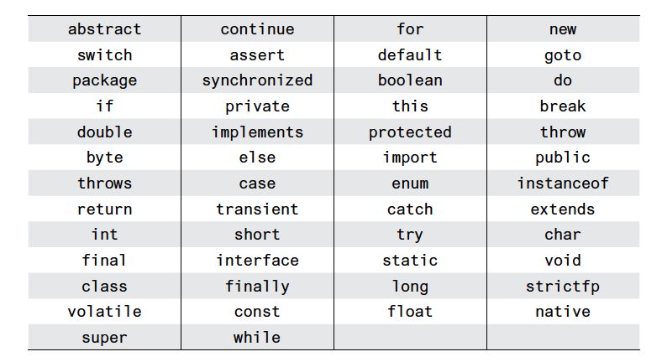
Keywords or Reserved Words
Words such as if are called keywords or reserved words and have special, predefined meanings.
Cannot be used as identifiers.

Slide 9
Where to Declare Variables
Just before using it, or
At the beginning of the section of your program (main method) that is enclosed in {}.
public static void main(String[] args)
{ /* declare variables here */ . . . }

Slide 10
Assignment Statements
An assignment statement is used to assign a value to a variable.
=
courseGrade = 99
Variable
Value
assignment operator
Notes:
We say, "The variable named courseGrade is assigned a value of 99," or more simply, "courseGrade is assigned 99."

Slide 11
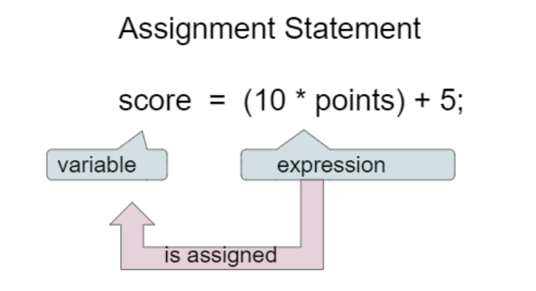
Assignment Statements
Syntax
Evaluated first
Another variable.
Literal or constant (e.g., number).
Variables and literals with operators (+,-).
Notes:
Evaluated first

Slide 12
Assignment Examples
amount = 3.99;
firstInitial = 'W’;
Final Grade = midterm + FinalExam;
score = numberOfCards + handicap;
eggsPerBasket = eggsPerBasket - 2;
byte = 8;

Slide 13
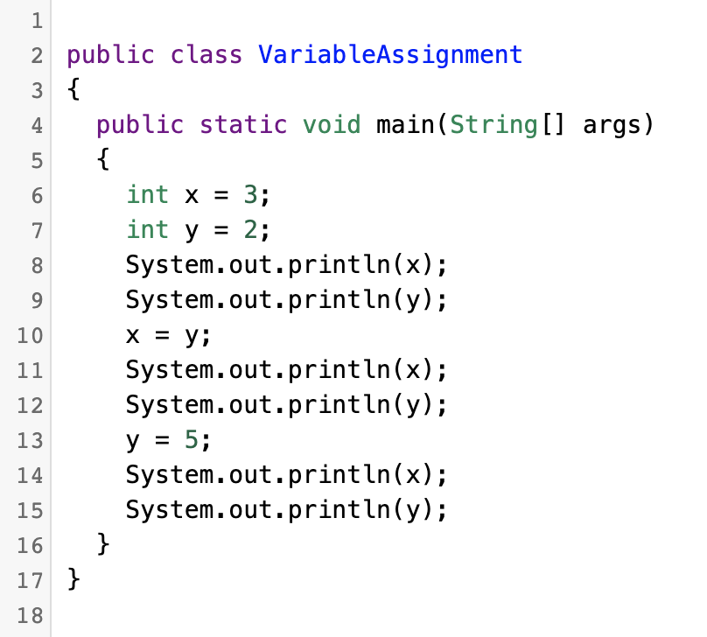
Assignment Statements
https://runestone.academy/ns/books/published/csjava/Unit1-Getting-Started/topic-1-4-assignment.html

Slide 14
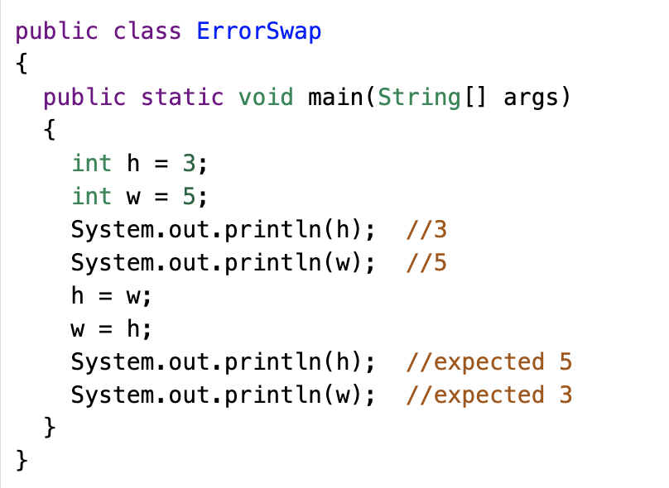
Assignment Statements
https://runestone.academy/ns/books/published/csjava/Unit1-Getting-Started/topic-1-4-assignment.html

Slide 15
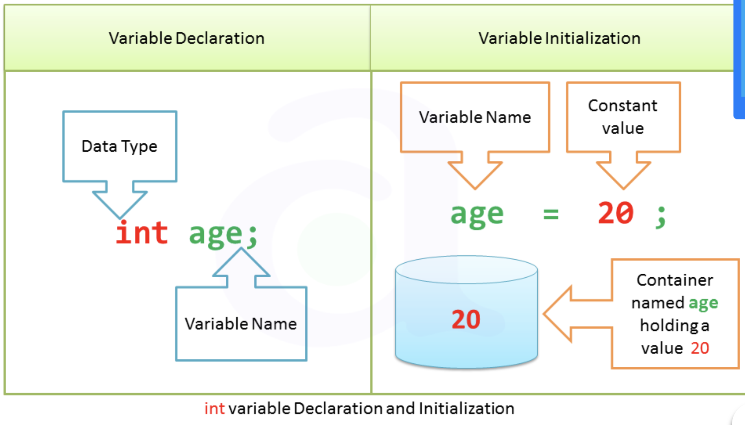
Initializing Variables
Uninitialized
(default value)

Slide 16

Initializing Variables
To protect against an uninitialized variable (and to keep the compiler happy assign a value at the time the variable is declared.
Examples:
int count = 0;
char grade = ‘A’;
int a =10, b=20, c=30;

Slide 17
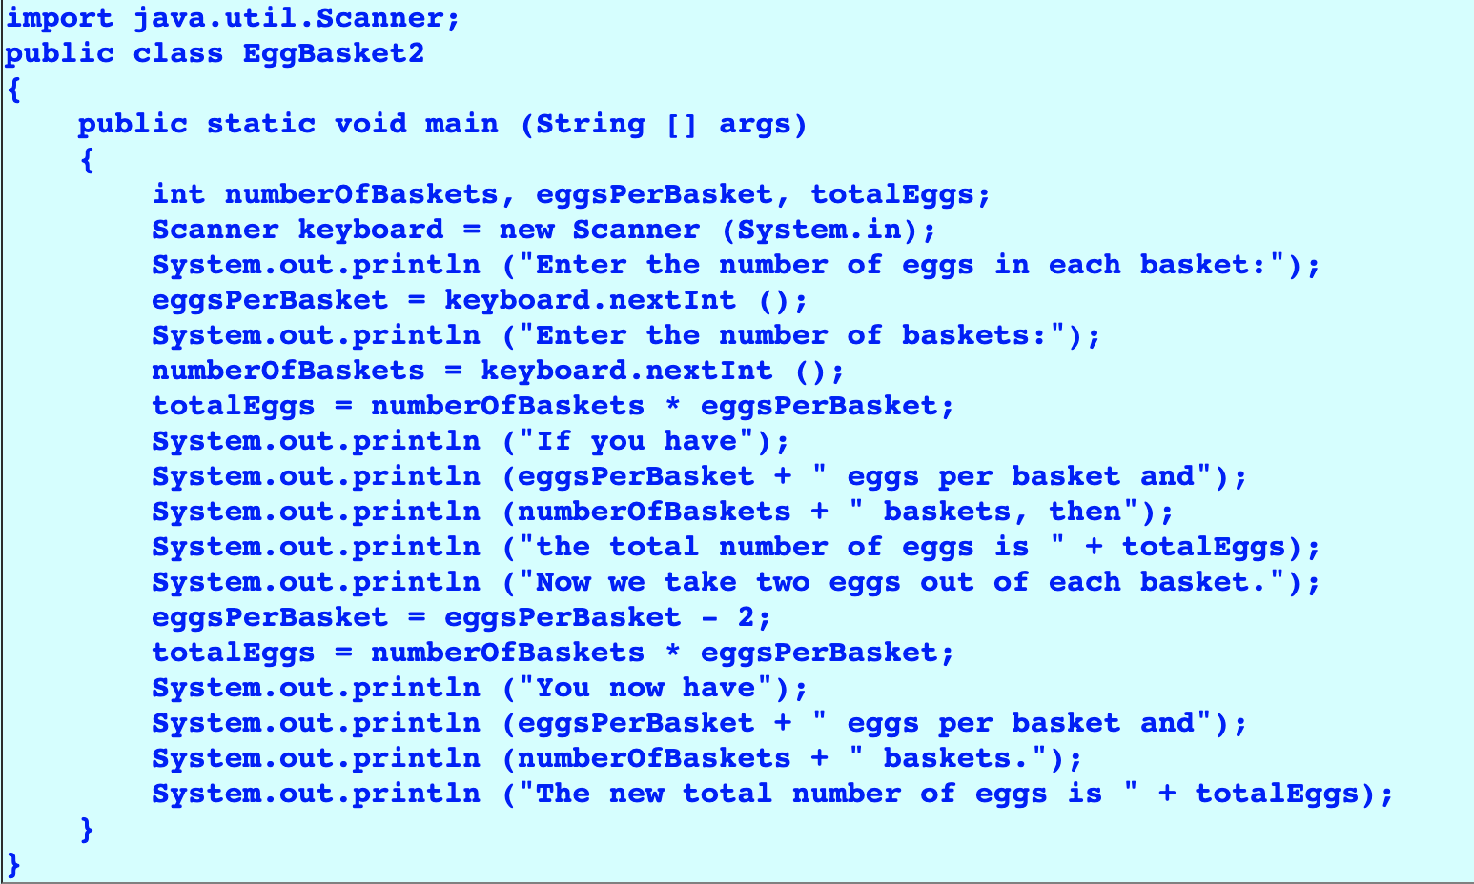
Sample Program

Slide 18
Sample Program (Output)

Slide 19
Constants
Literal expressions such as 2, 3.7, or 'y' are called constants.
Integer constants can be preceded by a + or – sign (no commas)
+2 , +199 , -5147483648 , 2.71828 , 29002, 0
Floating-point constants can be written
With digits after a decimal point or
Using e notation.

Slide 20
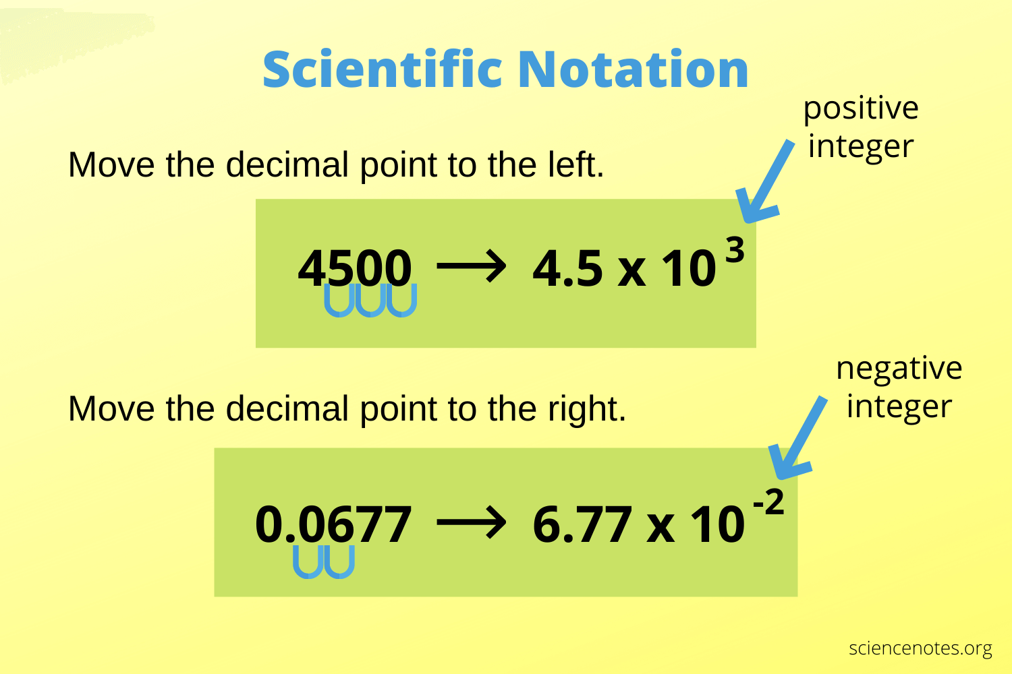
e Notation
4.5e3 = 45e2
6.77e-2
https://sciencenotes.org/scientific-notation-working-with-exponents/
Notes:
The number in front of the e does not need to contain a decimal point.

Slide 21
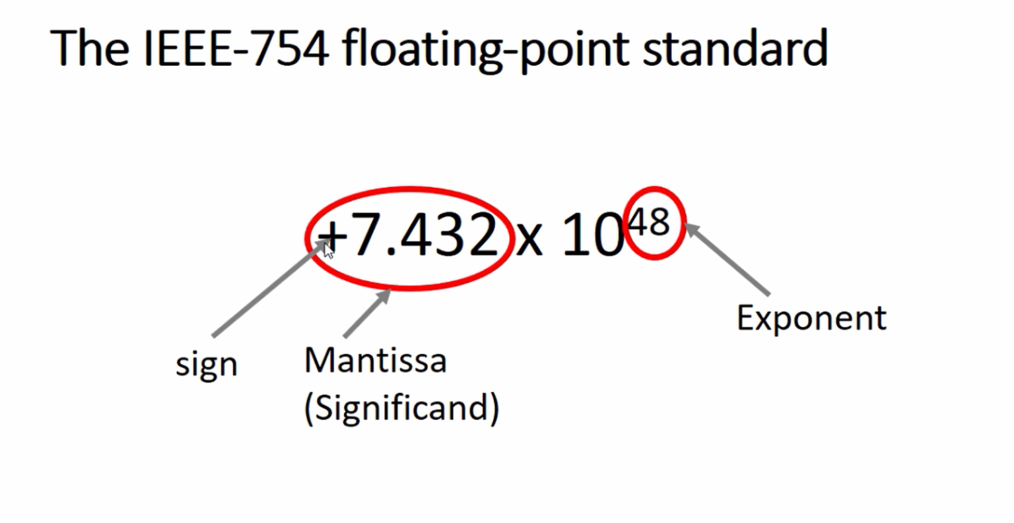
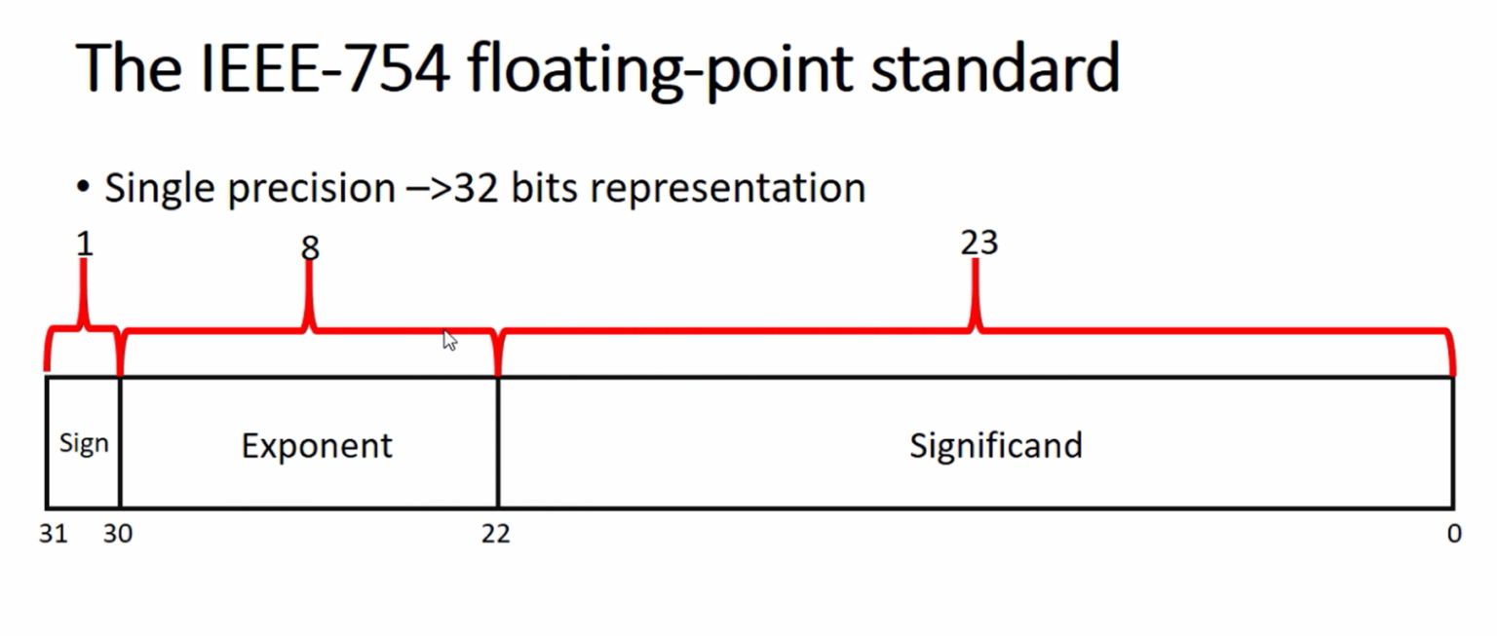
Floating-point
Floating-point numbers often are only approximations since they are stored with a finite number of bits.
1.0/3.0 is slightly less than 1/3.
1.0/3.0 + 1.0/3.0 + 1.0/3.0 is less than 1.
https://fastbitlab.com/single-vs-double-precision-floating-point-representation/

Slide 22
Named Constants
Java provides mechanism to …
Define a variable
Initialize it
Fix the value so it cannot be changed
public static final Type Variable = Constant;
Example:
public static final double PI = 3.14159;

Slide 23
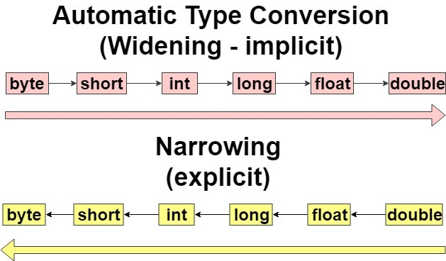
Type Casting (1/2)
When we assign value of a smaller data type to a bigger data type.
Notes:
The two data types are compatible.
When we assign value of a smaller data type to a bigger data type.

Slide 24
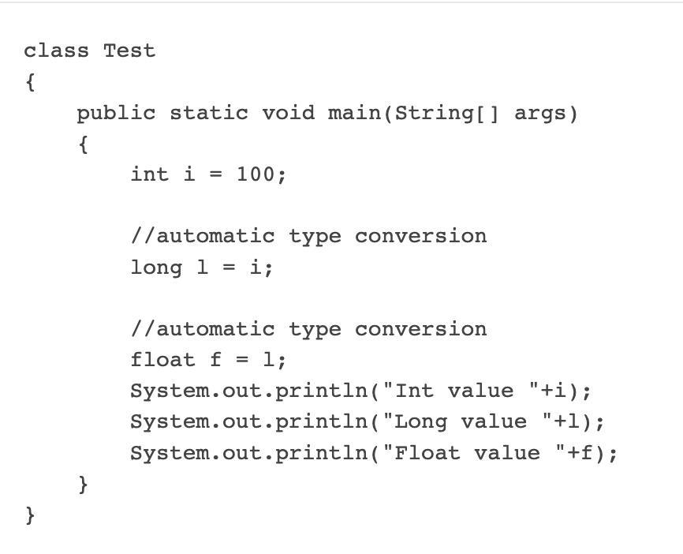
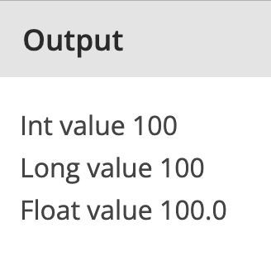
Type Casting (1/2)

Slide 25
Type Casting (1/2)
You can assign a value of type char to a variable of type int.
char

Slide 26
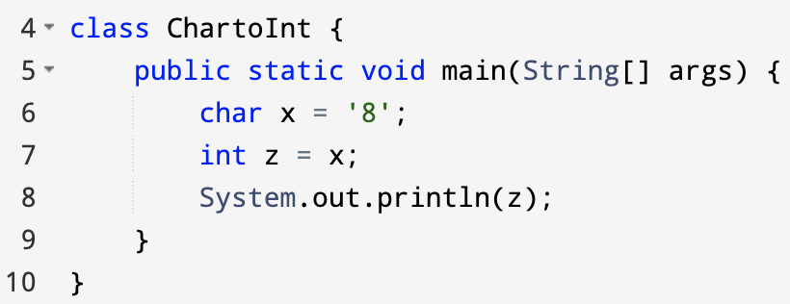
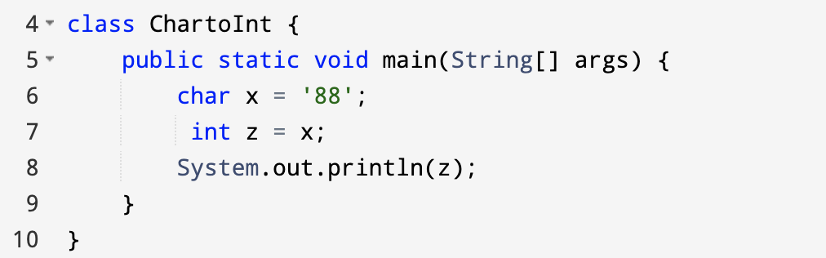
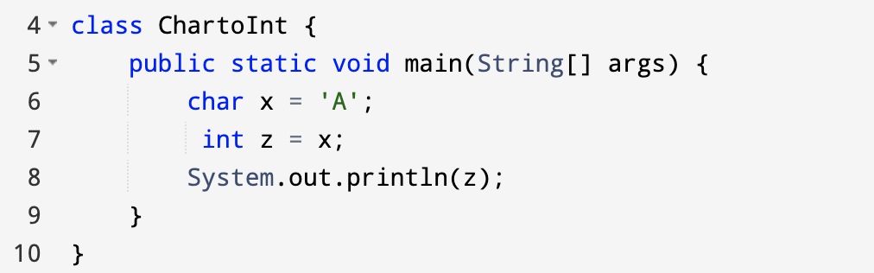
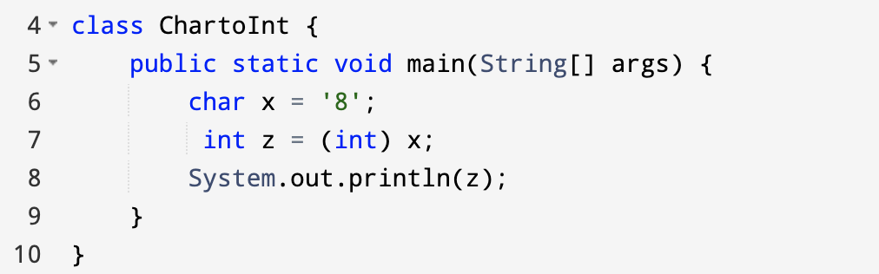
Type Casting (1/2)
You can assign a value of type char to a variable of type int.
Output: 56
Output: Error
Output: 65
Output: 56

Slide 27
Type Casting (2/2)
If we want to assign a value of larger data type to a smaller data type.
Notes:
If we want to assign a value of larger data type to a smaller data type we perform explicit type casting or narrowing.

Slide 28
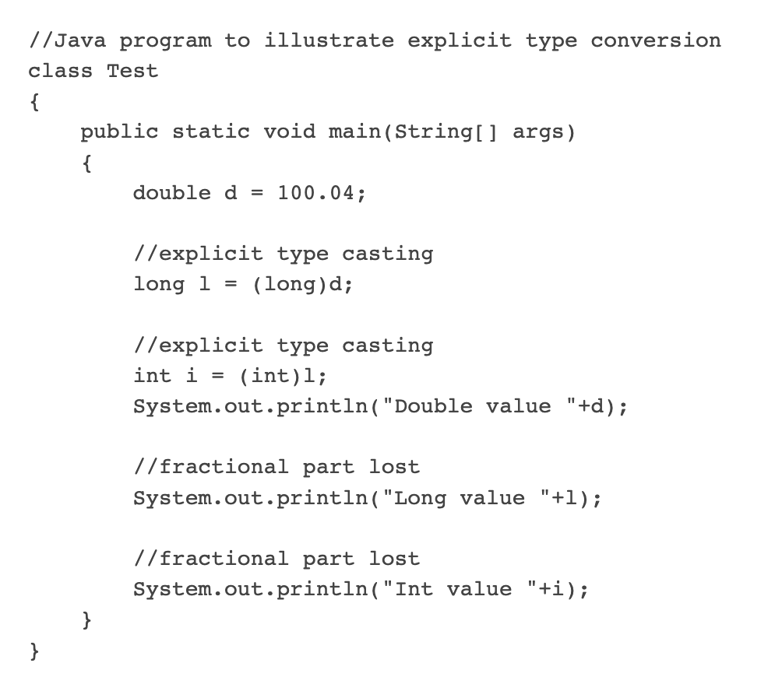
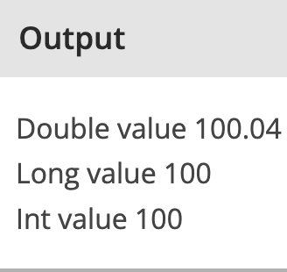
Type Casting (2/2)

Slide 29
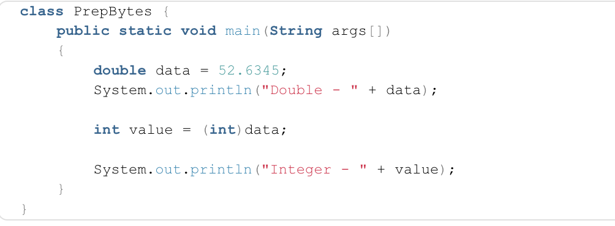
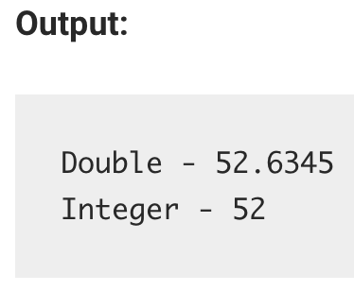
Type Casting (2/2)
[] args
Any nonzero value to the right of the decimal point is truncated rather than rounded.
Notes:
[] args

Slide 30
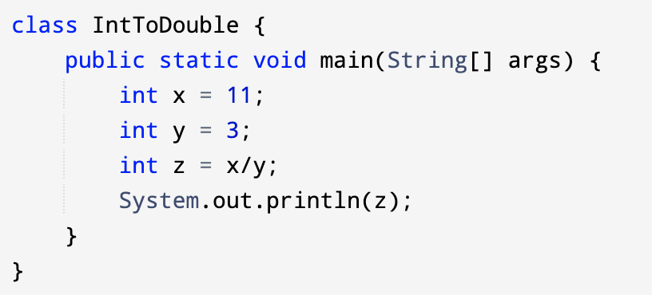
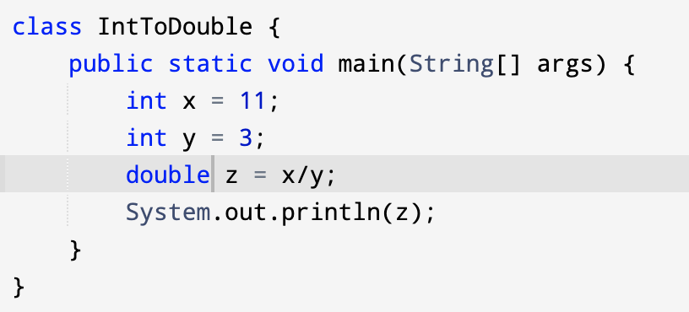
Type Casting
Output: 3
Output: 3.0
Notes:
Output

Slide 31
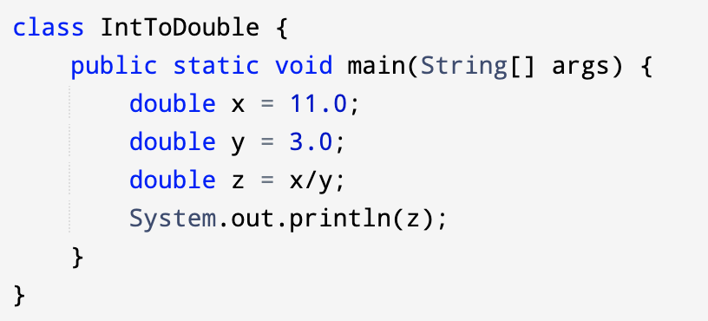
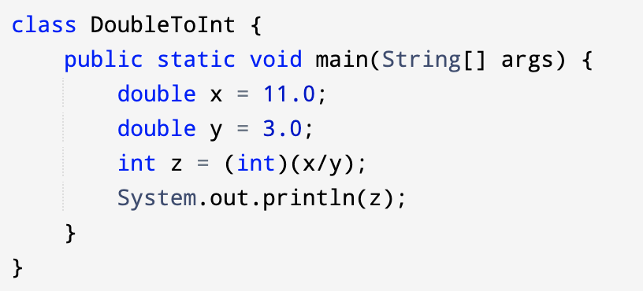
Type Casting
Output: 3.6666666666666665
Output: 3

